Slide 1
Microwave Controller
Brian lam, Michael Tolmajian, Michael Nava, Sarah Su

Slide 2
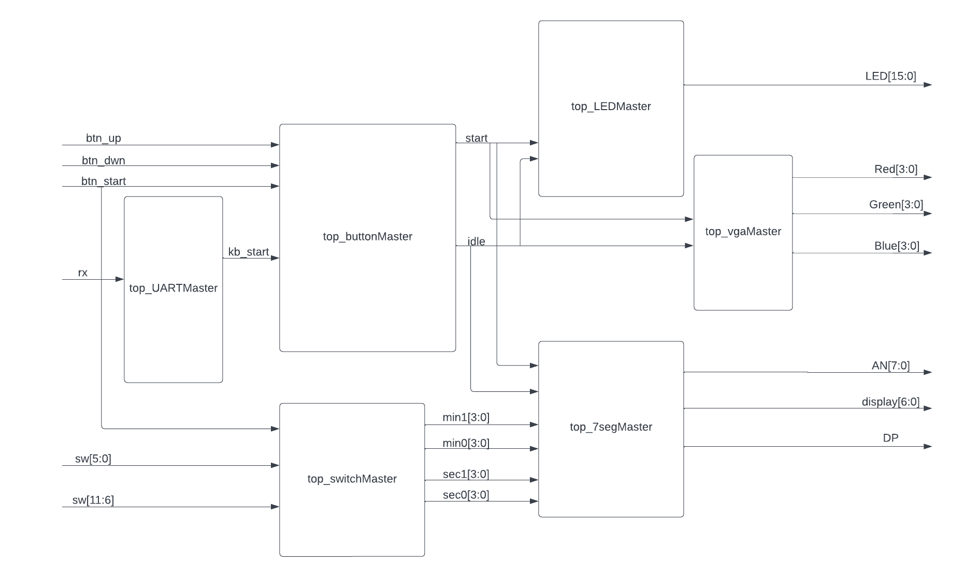
Microwave Controller
Overall Design

Slide 3
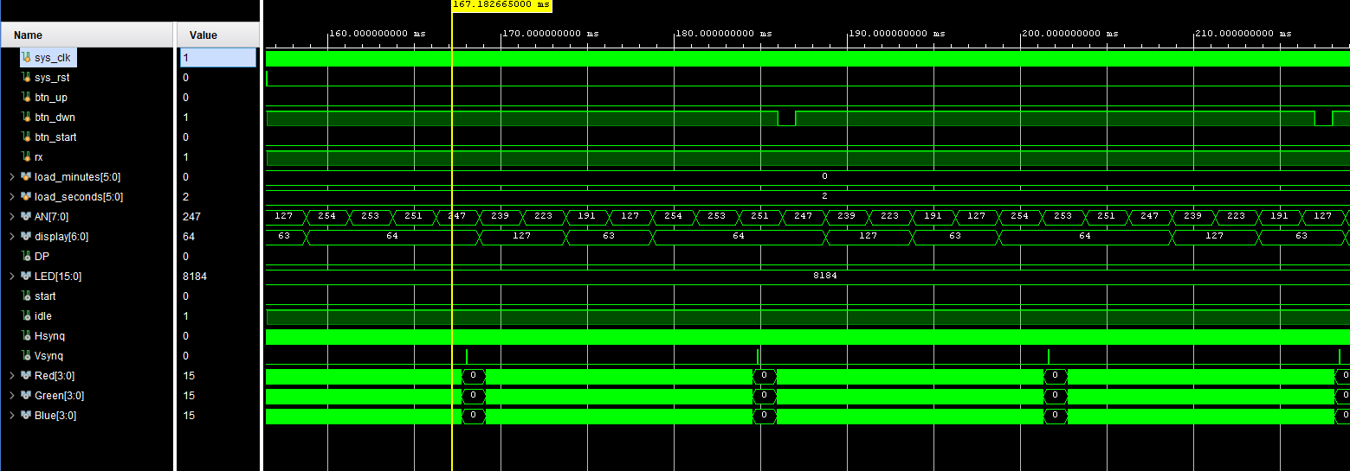
Microwave Controller
Top Simulation

Slide 4
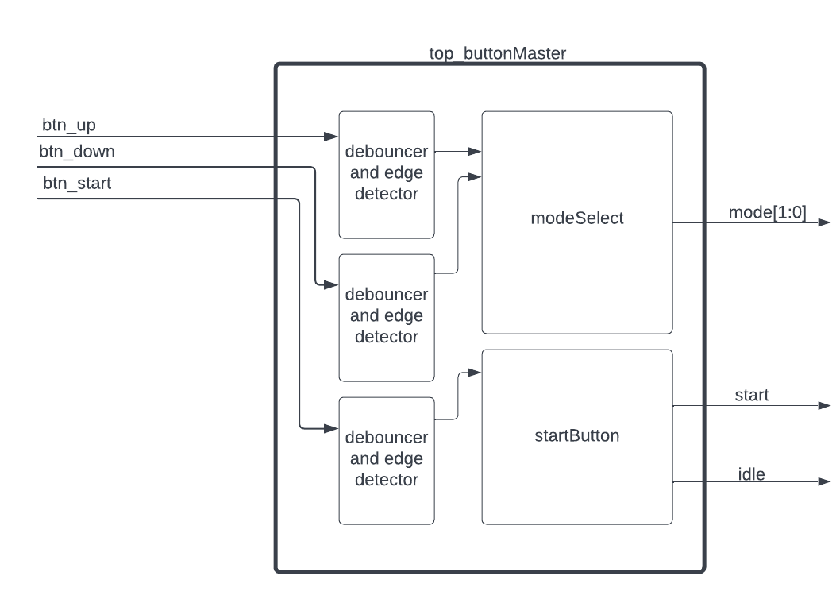
Buttons
Design Overview

Slide 5
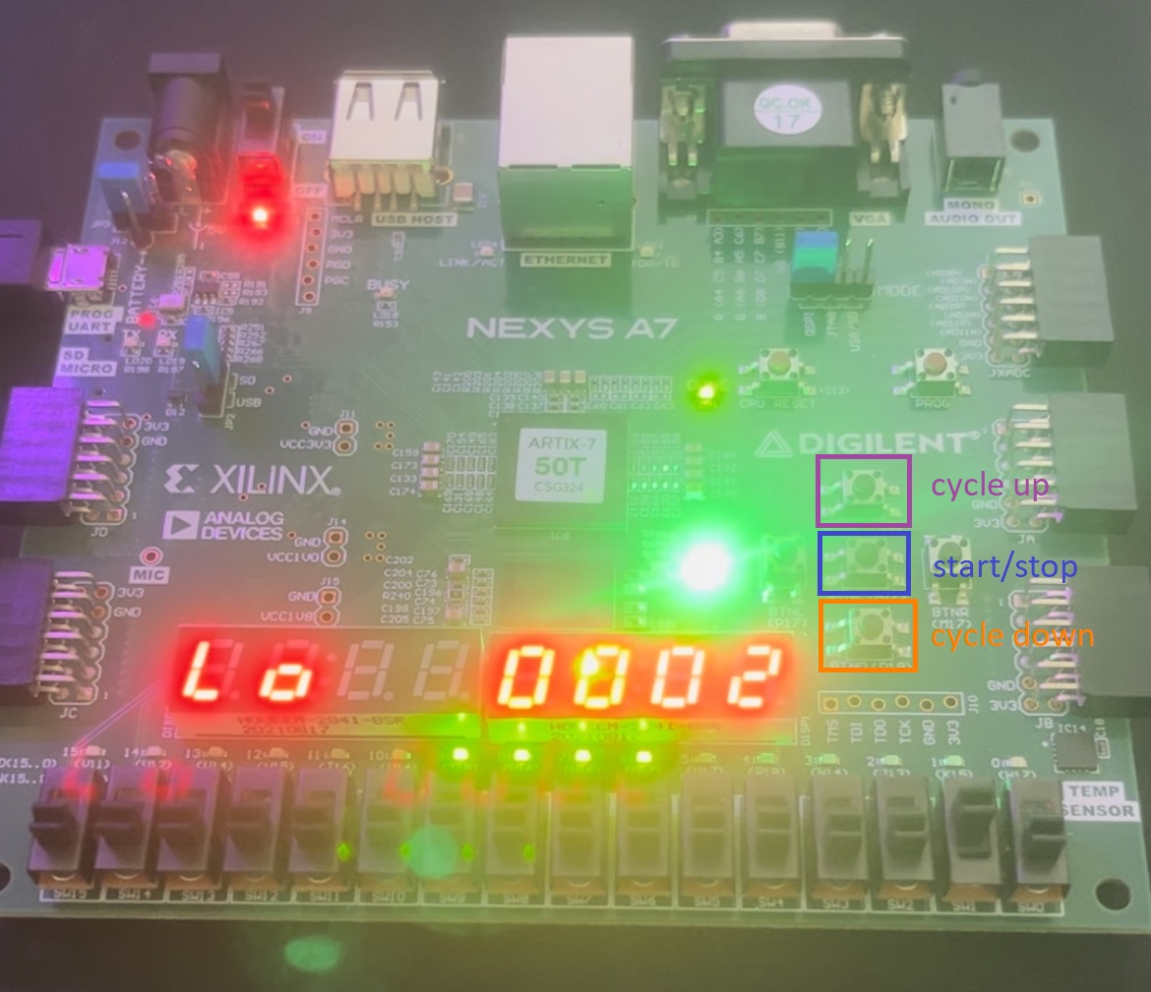
Buttons
4 total buttons
Up cycle for power level
Down cycle for power level
Start/Stop
Reset (for entire system)
Edge detector state machine
Detect only the positive edge of buttons
Each button is debounced
synched to the clock

Slide 6
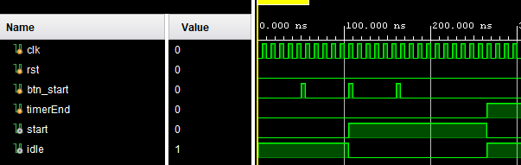
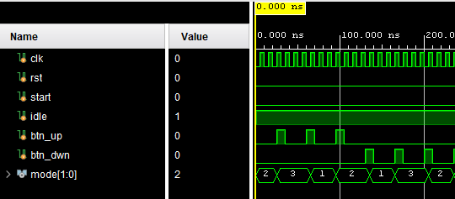
Buttons
Up/Down cycle
Simple state machine
Mealy - with button as input and mode bus as output
Three specific “mode” outputs for the three specific levels
Start/Stop
Always block constantly checking for button input
Invert start/idle signals for every button press

Slide 7
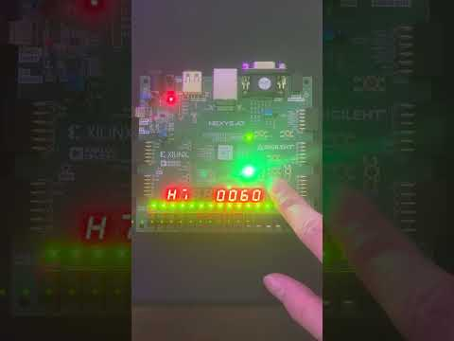
Buttons
DEMO

Slide 8
LEDs
16 total LEDs
Used all available LEDs on our Nexys A7 100T FPGA
Controlled collectively in one array, [15:0]LED
4x16 Decoder
Each LED lights up using a decoder
One at a time
Up/Down 4-Bit Counter with a Twist
16 values, log₂(16) = 4 bits (0000₂ to 1111₂)
Clock Manager
32-bit Counter
32-to-1 Multiplexer

Slide 9
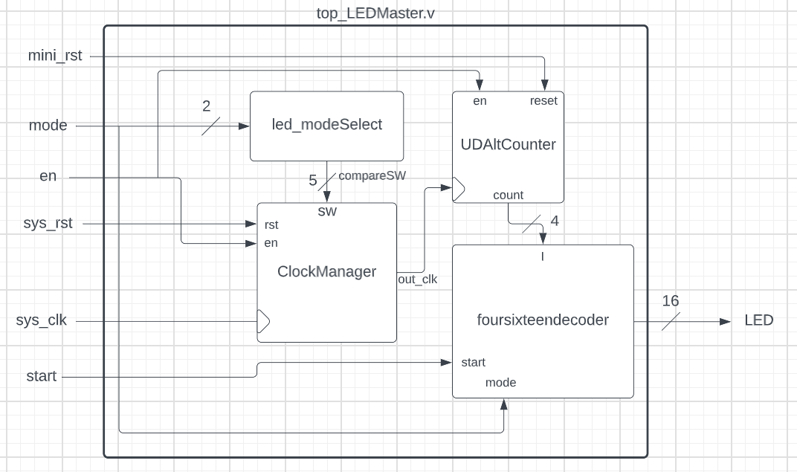

Slide 10
LEDs
Mode Selecting Module using Case statements (led_modeSelect.v)
1. Low
If mode is 2'b01, the 21st bit of the 32-bit counter.
5 switches for the 32-1 MUX = 5'b10101
Clock frequency = 10⁸ / 2²¹ Hz
2. Normal
If mode is 2'b10, the 20th bit (twice as frequent as Low)
5 switches for the 32-1 MUX = 5'b10100
Clock frequency = 10⁸ / 2²⁰ Hz
3. High
If mode is 2'b11, the 19th bit (twice as frequent as Normal, four times more frequent than Low)
5 switches for the 32-1 MUX = 5'b10011
Clock frequency = 10⁸ / 2¹⁹ Hz

Slide 11
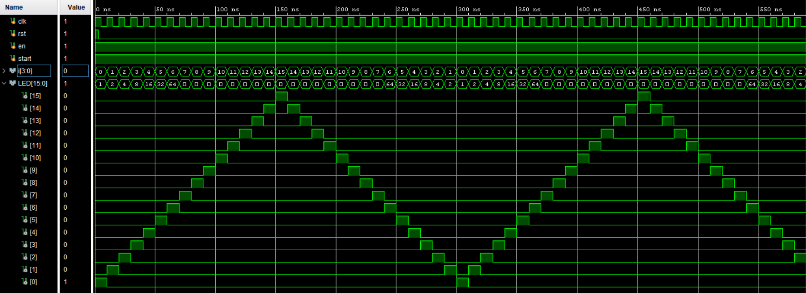
LEDs
Up/Down 4-Bit Counter (UDAltCounter.v)
The switch for U/D is controlled by the module.
It alternates. Hence, UDAltCounter.
U/D is initially set to 0 (counting up to 15, right to left on LED set).
When the count is 15, U/D is set to 1 (counting down to 0, left to right on LED set).
U/D Counter and 4x16 Decoder utilized in a testbench; U/D alternates.

Slide 12
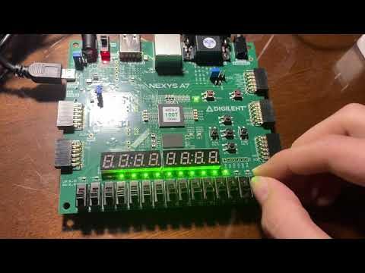
LEDs
DEMO

Slide 13
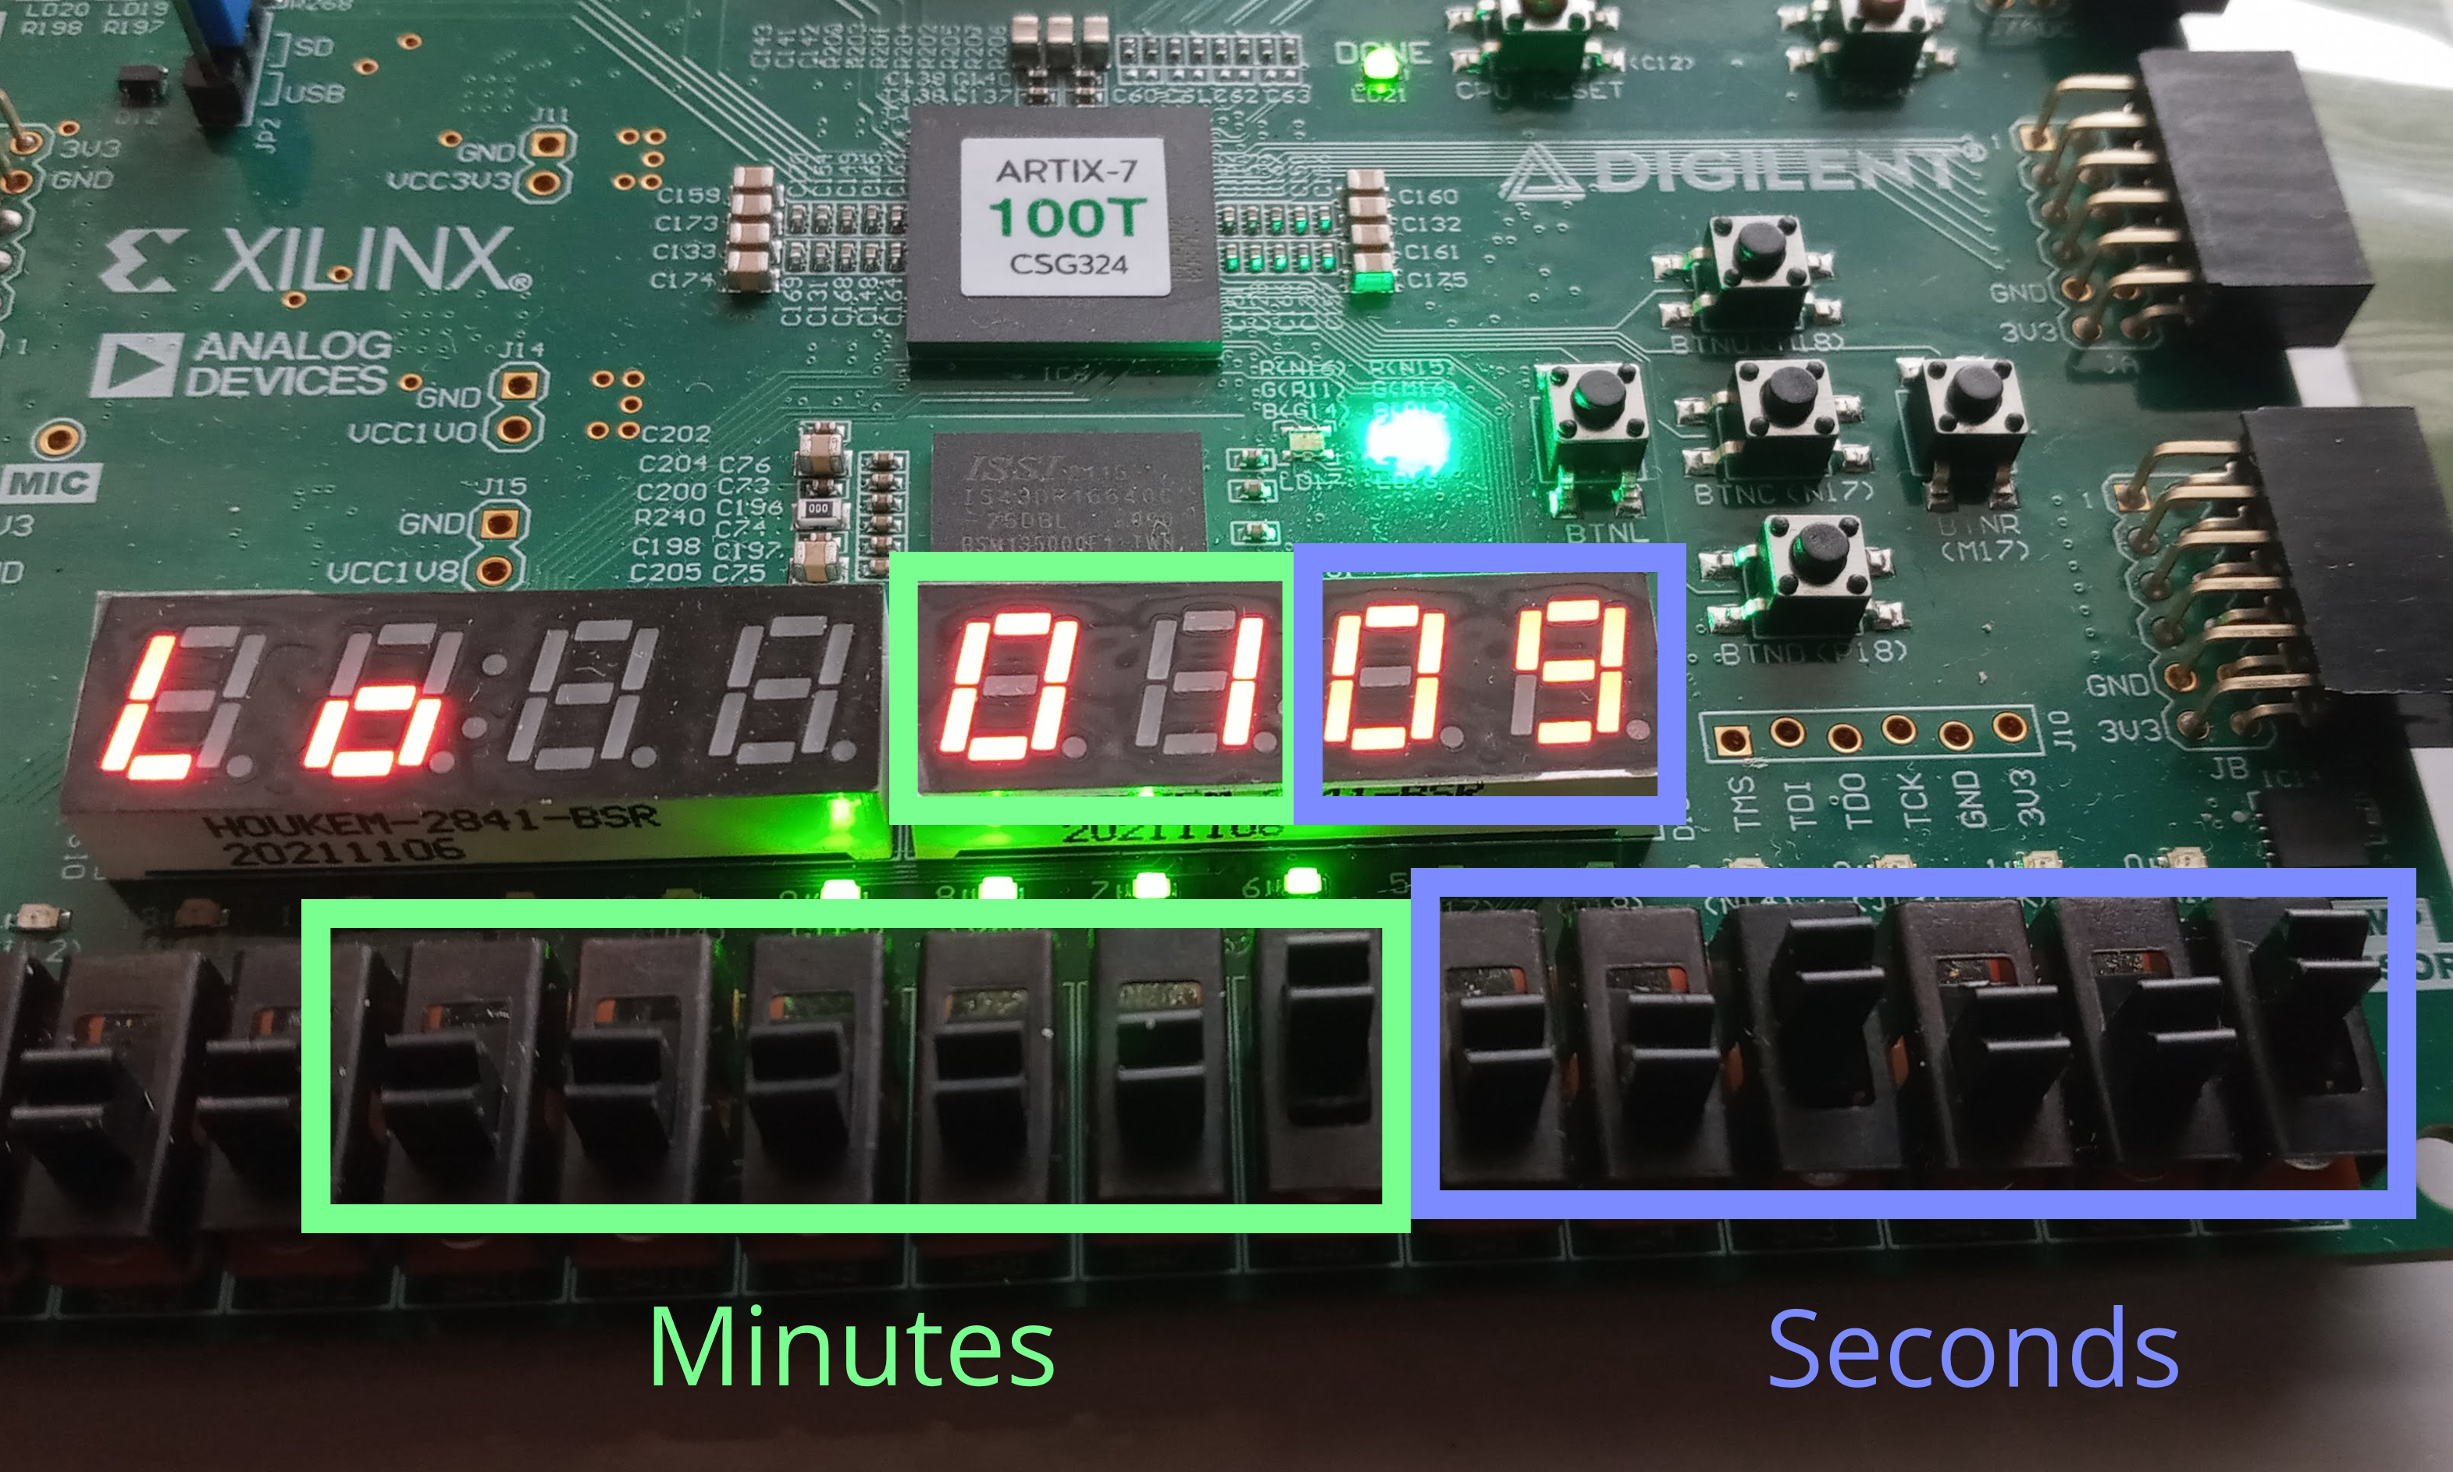
Switches
12 total switches
Sets time for countdown
6 for minutes
6 for seconds
Binary representation

Slide 14
Switches
Minute-Second Down Counter
Decrements minutes every minute
Decrements seconds every second (when seconds reaches 0, next value will be 59)
Starts counting from the time indicated by the switches after the Start/Stop button is pressed
Start/Stop button pauses/resumes the counting
Stops counting when minutes = 0 and seconds = 0
Resets to initial switch values when Reset button is pressed
Digit Separator
Separates the minutes and seconds into 2 digits using division and modulus operator

Slide 15
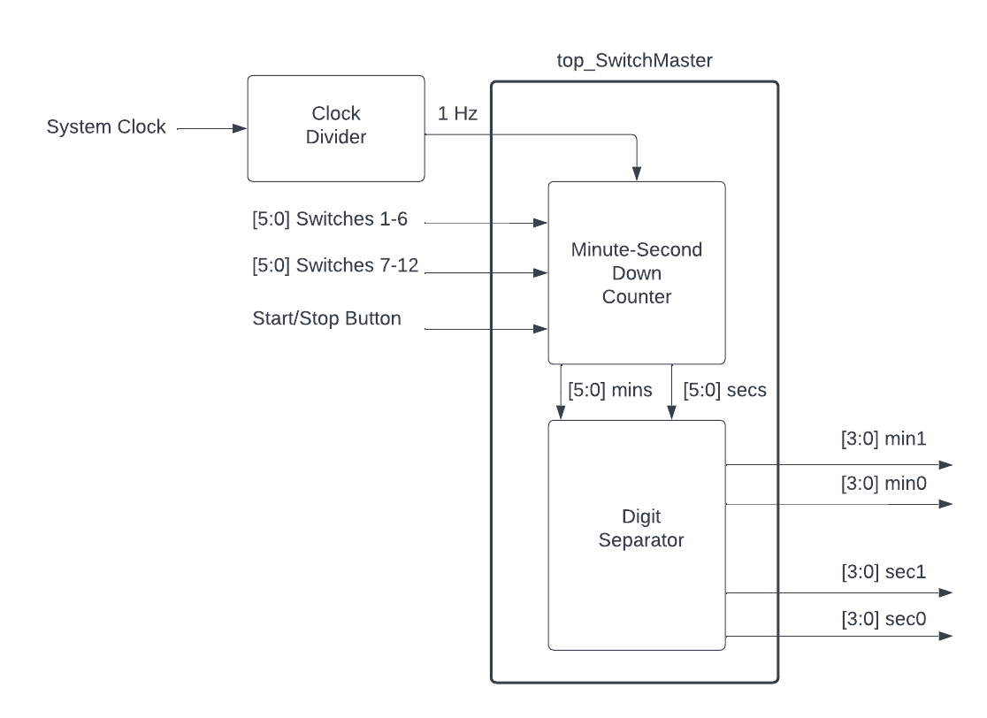
Switches Design Overview

Slide 16
7 Segment Display
6 total 7 Segment Displays
2 used to display the mode
4 used to display the timer (2 digits for minutes and 2 digits for seconds)
Clock Divider
Produces a 1 Hz and 400 Hz clock signals
1 Hz clock is used in the minute-second down counter
400 Hz clock is used in the anode controller to control the refresh rate of the 7 Segments

Slide 17
7 Segment Display
2 total 7 Segment Displays to display the mode
If mode is 2'b01, the digits will display 'L o'
If mode is 2'b10, the digits will display '- -'
If mode is 2'b11, the digits will display 'H i'
4 total 7 Segment Displays to display the timer
Display the minutes and seconds in BCD

Slide 18
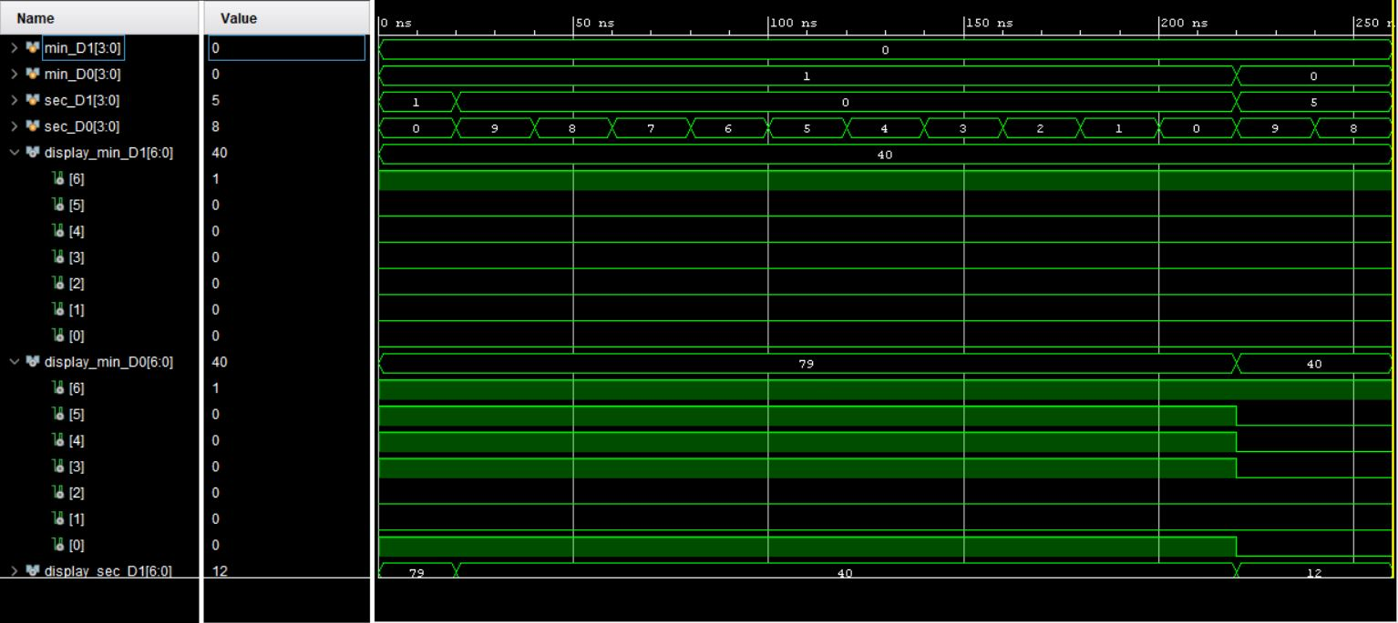
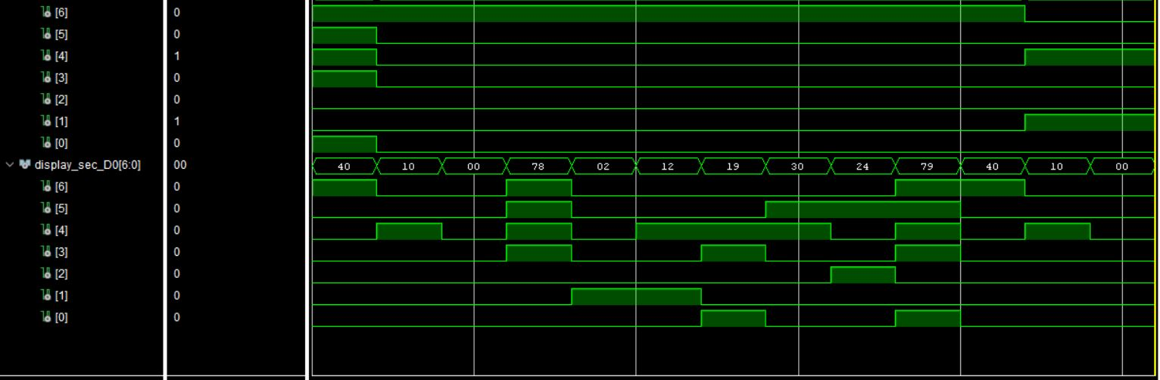
Display patterns for timer

Slide 19
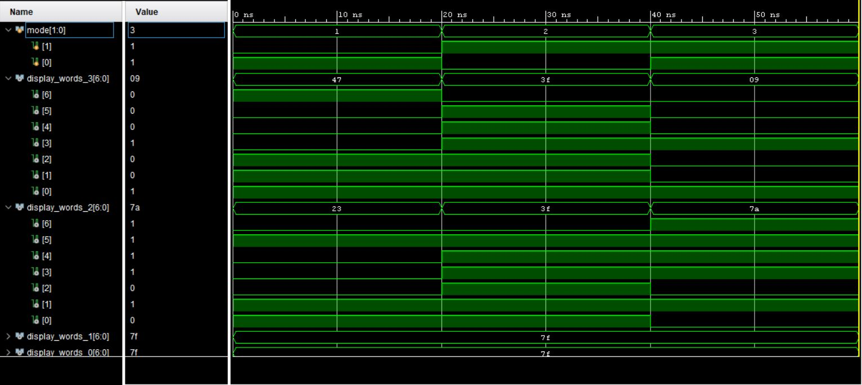
7 Segment Display
Display patterns for modes

Slide 20
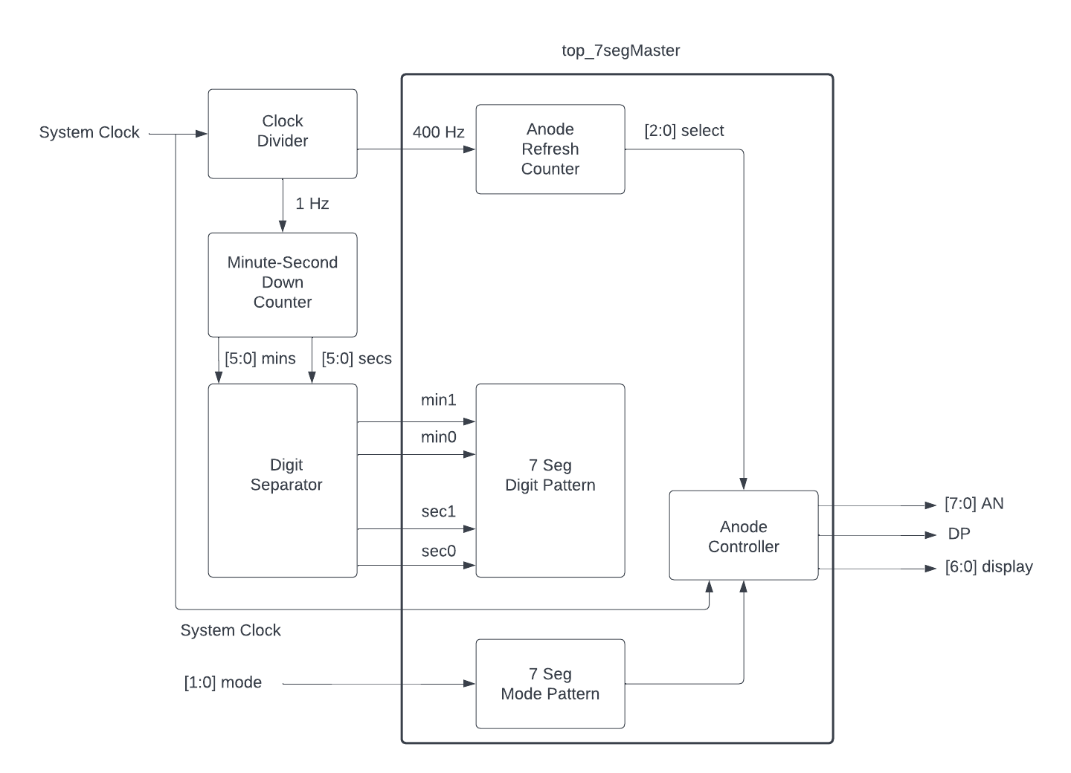
7 Segment Display Design Overview

Slide 21
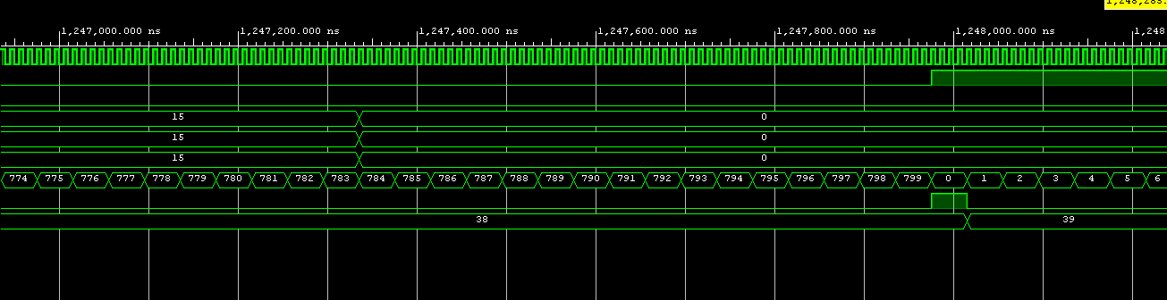
VGA
Three modules total
Horizontal counter
Vertical counter
Top module
Horizontal counter
Simple up-counter
0 – 799
25.1MHz clock
Enable signal output for Vertical counter every cycle
Vertical counter
Simple up-counter
0 – 524
25.1MHz clock
Enable signal input from Horizontal counter

Slide 22
VGA
Top module
Instantiate Horizontal and Vertical counter
3-bit RGB registers to control color within always block
Assigns RGB output values when counters in addressable video time
25.1MHz clock sensitive always block
25MHz clock sensitive always block
Lots of if else if statements to control VGA design output
Calculated values of horizontal and vertical counters to design microwave image chunks at a time

Slide 23
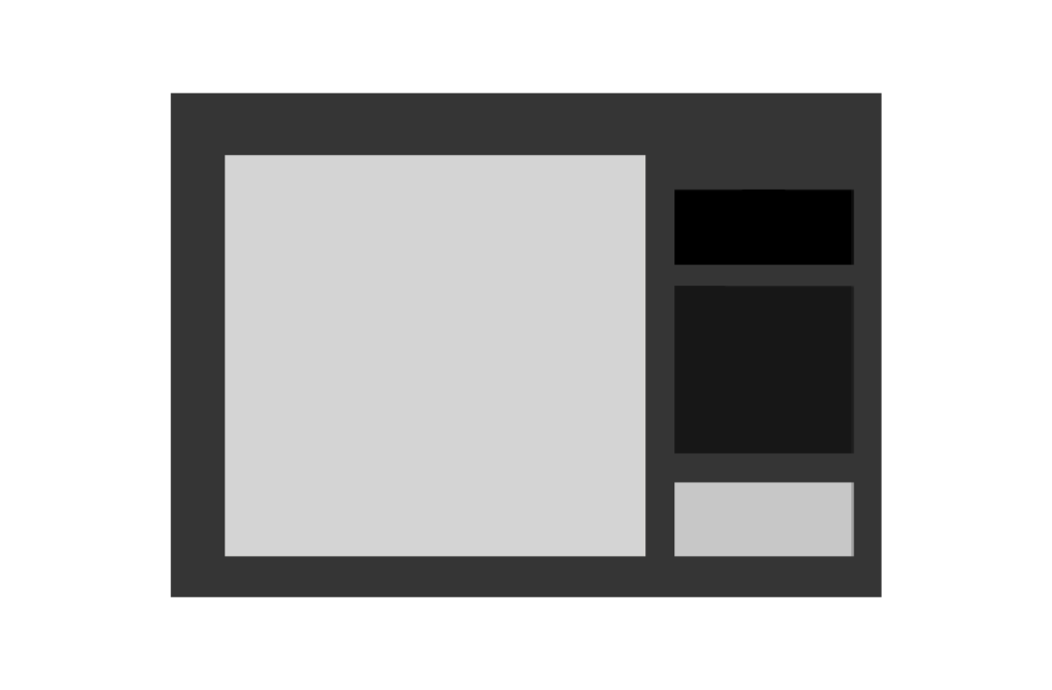
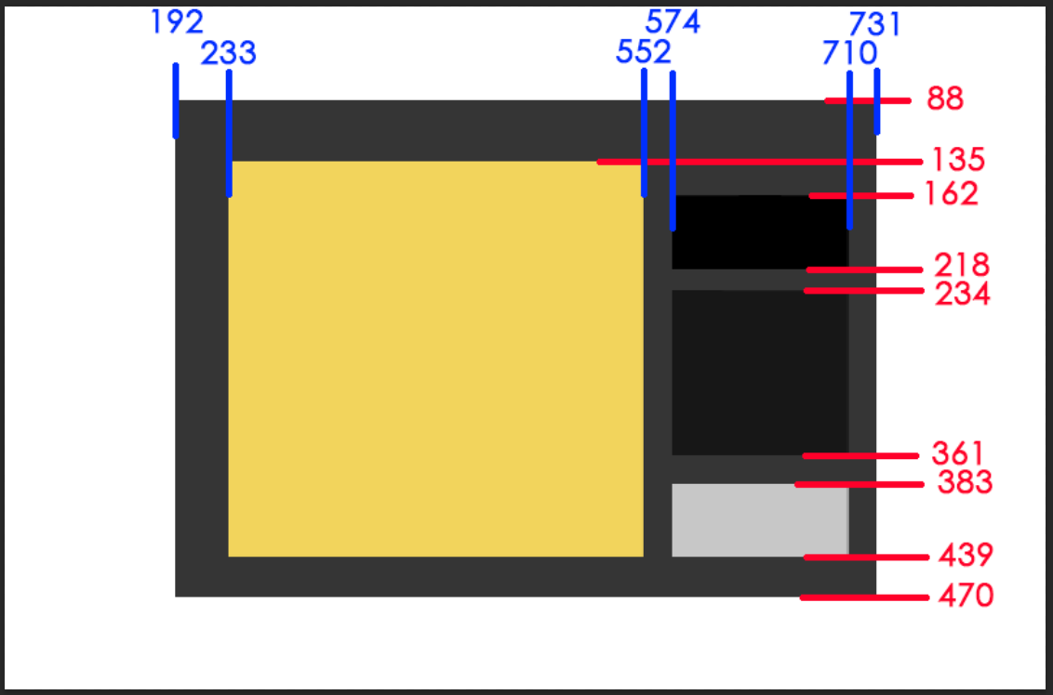

VGA
PICTURES
IDLE
ON

Slide 24
UART
Baud rate generator
9600 bits per second
Uses timer ticks to read value about halfway into each data bit
Transmitter
Takes 8 serial inputs one bit at a time and outputs 8 bits in parallel
Receiver
Takes 8 serial inputs one bit at a time and outputs 8 bits in parallel
FIFO (first in, first out)
Stores each 8-bit value until ready to be used

Slide 25
UART
Only receiver is necessary for this project
Serial communication only from PC to board through microUSB port
Keyboard inputs will be received by the FPGA board
Receiver pulse signal
Receiver module outputs one clock cycle pulse when 8 bits have been processed
Pulse will trigger start/stop mechanism like a button

Slide 26

Thank You!

